Slide 1

MService MSCTD-644
Confidential to Selfservit Solutions

Slide 2
Checklist
1.Handover Documents .

Slide 3
Repository Name:
1.DELAVAL-in_LIVE

Slide 4
TEST ENVIRONMENT DETAILS: URL : https://uat-in-uat.mservice.net/ Co-ordinator login : oemcoord1/test

Slide 5
Impact Analysis:
The files which is going to add and modify is
DB/DATA SCRIPTS/FR-2226/01.grant_permission.sql
DB/PROCEDURES/dbo.sp_retrieve_manage_call_register_details.StoredProcedure.sql
DB/PROCEDURES/dbo.sp_save_manage_customer_loc_details.StoredProcedure.sql
Website/mservice/retrieve_manage_call_register_details.OutputMessage.xsd
Website/webui/scripts/js/fn_manage_call_register_edit.js
Website/webui/scripts/js/fn_manage_call_register_pe_edit.js
Website/webui/scripts/js/fn_manage_call_register_sa_edit.js
Website/webui/scripts/js/fn_manage_call_register_se_edit.js
Website/webui/scripts/js/fn_manage_call_register_vi_edit.js

Slide 6
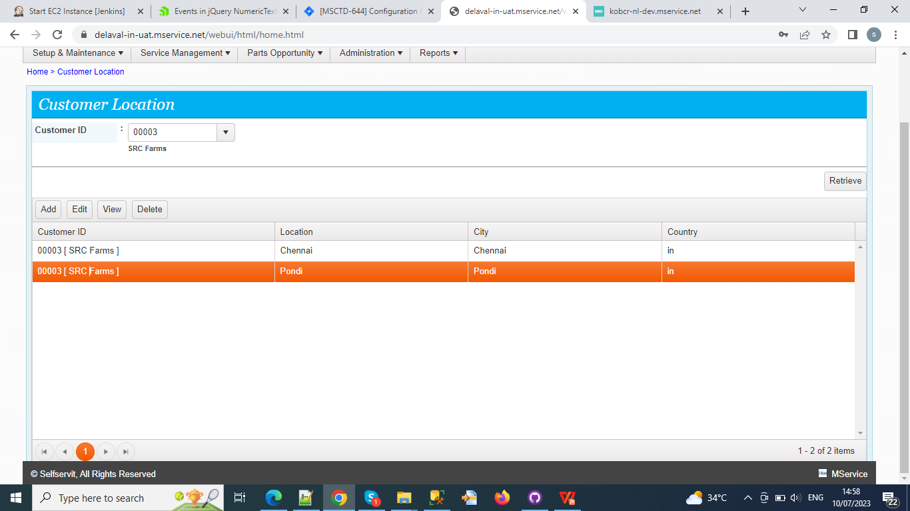

Slide 7
